Slide 1
Interrupts, TRAPs, and Exceptions

Slide 2
Outline
The Operating System Machine Layer
Program Discontinuities
Interrupts
TRAPs
Exceptions

Slide 3
Operating System Machine Layer
Operating Systems are about sharing resources and protecting users from themselves and others.
Certain operations require specialized knowledge and protection:
Specific knowledge of I/O device registers and the sequence of operations needed to use them
I/O and memory resources shared among multiple users/programs; a mistake could affect lots of other users/processes!
Not every programmer knows (or wants to know) this level of detail, so we abstract them in an Operating System Machine Layer
We transparently provide service to I/O devices and we notify user programs of unexpected situations
We provide service routines or system calls (as part of operating system) to safely and conveniently perform low-level, privileged operations

Slide 4
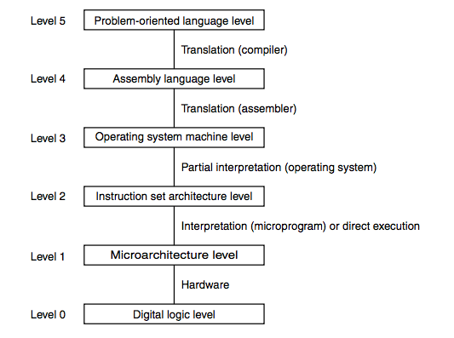
Road Map

Slide 5
What are Program Discontinuities
Interrupts
An I/O device is reporting a completion or an error (e.g. “Read completed”)
TRAPs
The program is calling a privileged operating system subroutine (e.g. “Read a line from a file”)
Exceptions
Something unanticipated has happened
Hardware error in the CPU or memory
Program error (e.g. illegal opcode, divide by zero)

Slide 6
Program Discontinuities
We combine the discussion of program discontinuities because they are all handled in very similar ways
Save the state of the CPU
Raise the CPU privilege level
Call an operating system routine
Restore the state of the CPU and the privilege level
Resume the executing program where it left off
Does this resemble an unplanned subroutine call?
(The microcode isn’t subject to program discontinuities; its job is to provide that abstraction for the machine language program)
Properties
Synchronous with the program (TRAPs and some exceptions) or asynchronous (interrupts and other exceptions)
Anticipated by the programmer (TRAPs) or unanticipated (interrupts and exceptions)

Slide 7
Interrupts
What are they?
Why do they exist?
Generation of Interrupt Signal
Device
Priority
FSM Mods

Slide 8
What are they?
Modifications to the hardware of the datapath and I/O system and additional software to allow an external device to cause the CPU to stop current execution and execute a "service" routine and then resume execution of the original program. Hence, an interrupt.
Remember the INT signal that the LC-3 microsequencer can test? That signal is what an interrupt ultimately needs to raise.

Slide 9
Why Do They Exist?
Interrupts can be significantly more efficient than polling and are especially useful in an environment where there are numerous devices and multiple concurrent activities
Polling on the other hand is appropriate where there is a high likelihood of quick success or the CPU has nothing better to do
An interrupt is an unscripted subroutine call, triggered by an external event.

Slide 10
Device Status Register
When a device goes “ready” and its IE bit is set, it will generate an interrupt signal
There are several more steps that must allow the interrupt signal to pass before the microsequencer can see it
Ready Bit
Interrupt Enable Bit
rdy
IE
Interrupt

Slide 11
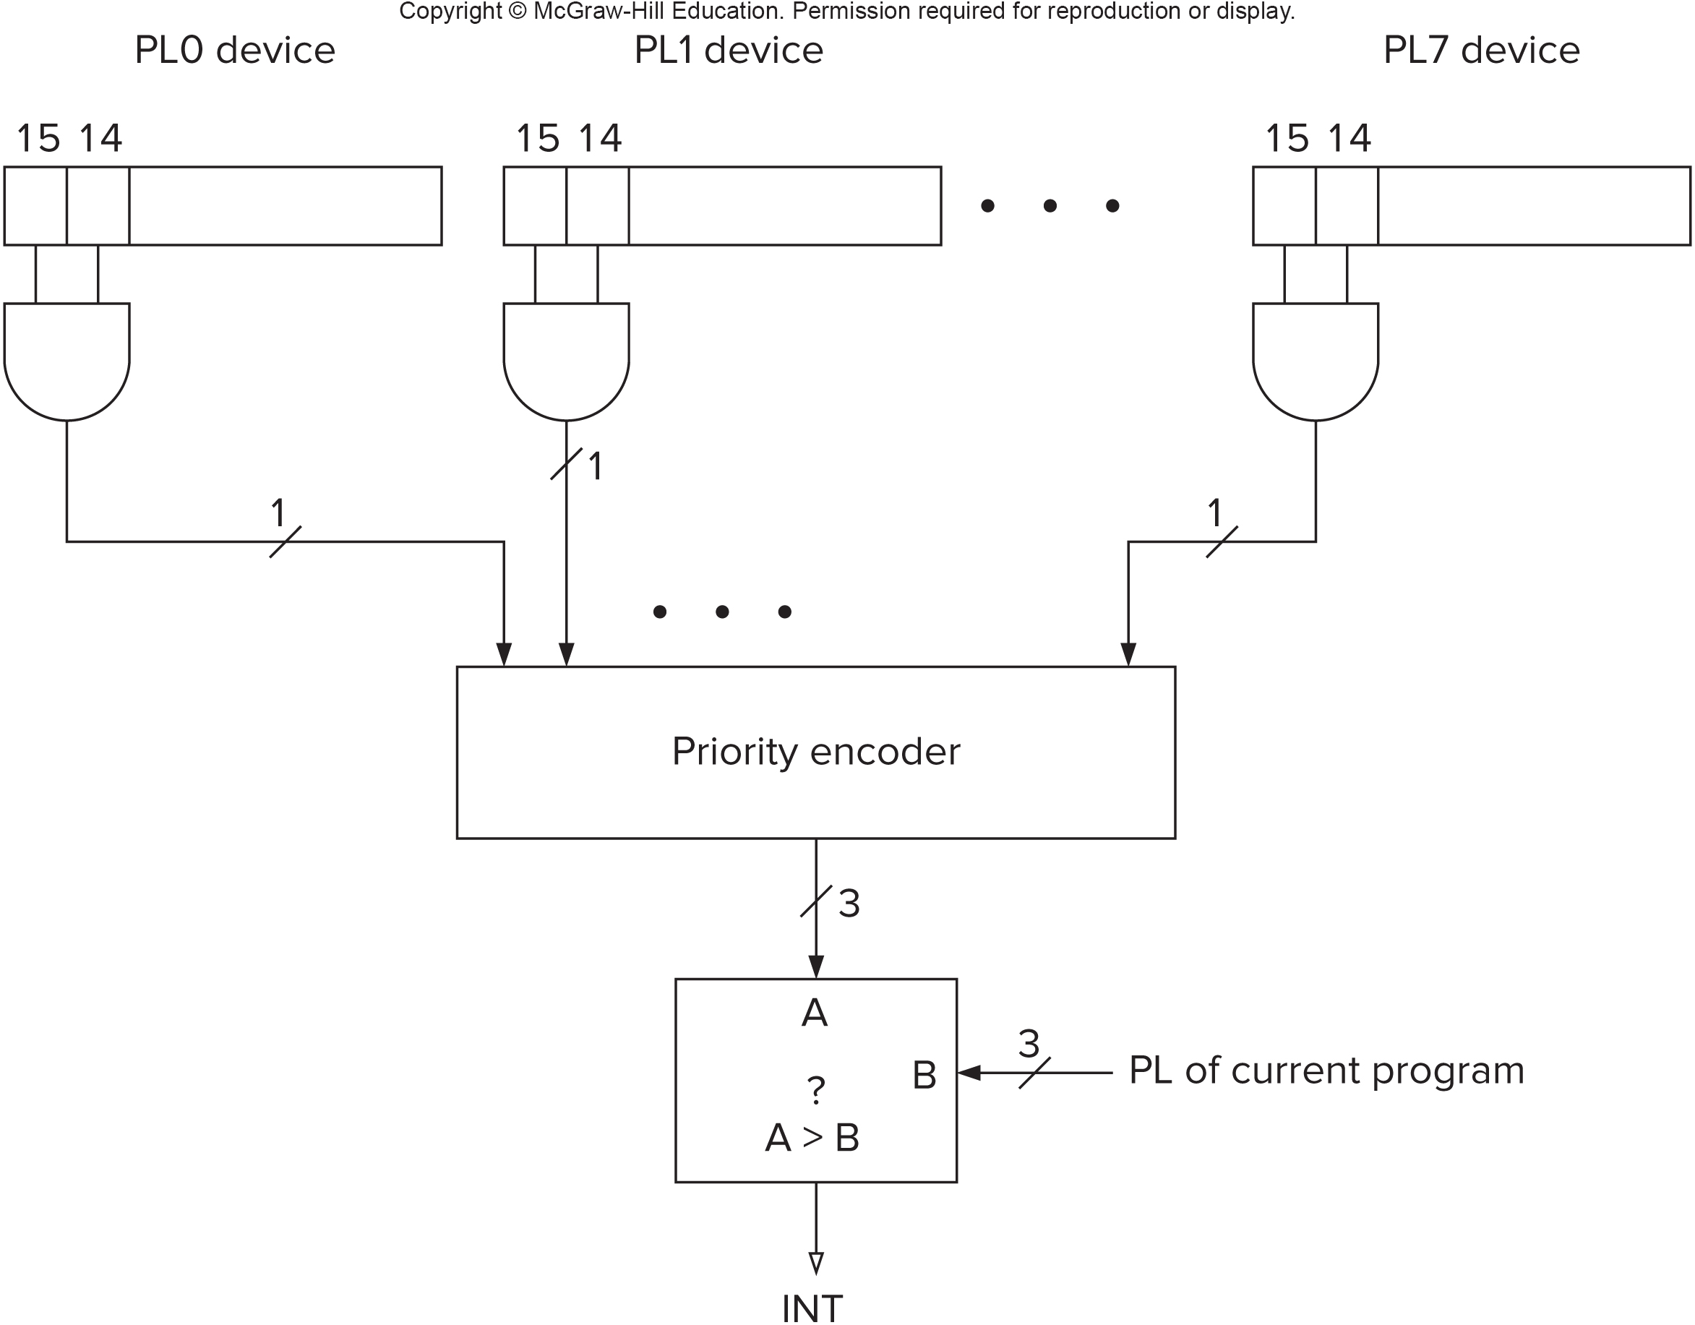
Interrupt Circuitry, for Completeness
When a device (or devices) interrupts, the priority encoder outputs the highest priority with an interrupt signal
If the priority is greater than the priority in the PL register, the comparator asserts the INT signal to the microsequencer
The new priority is stored in PL
The interrupting device ID is stored in the INTV register (circuit not shown)

Slide 12
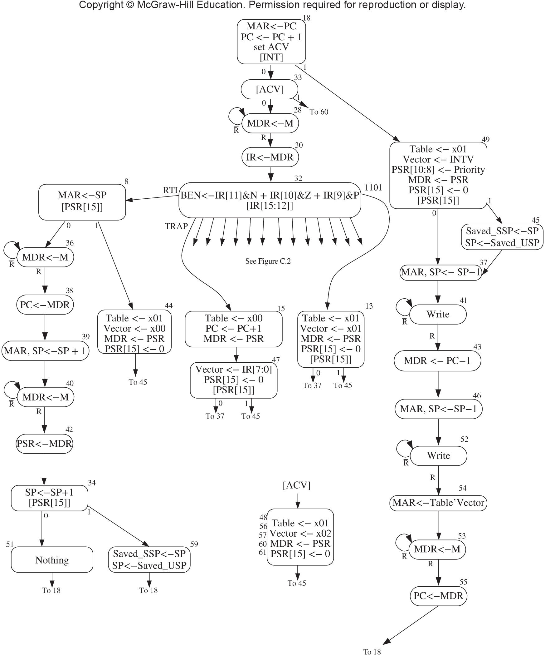
Detecting Interrupts
When the I/O device is allowed to signal an interrupt, the INT control signal to the microcode FSM is asserted
The first state in the FETCH cycle tests to see if INT is asserted
If it is, the microcode transfers to state 49 and sets up a call to the interrupt service routine

Slide 13
Where to Save Processor State?
Can’t use general purpose registers
Programmer doesn’t know when interrupt might occur, so she can’t prepare by saving critical registers.
When resuming, need to restore state exactly as it was.
Can’t use memory allocated by service routine
Must save state before invoking routine, so the hardware wouldn’t know where.
Also, interrupts may be nested – that is, an interrupt service routine might also get interrupted!
Use the existing supervisor stack!
Top of the stack is already known in R6.
Push state to save, pop to restore.

Slide 14
Supervisor Stack, for Completeness
Interrupts are handled on the supervisor-mode stack to protect them from user mode programs
R6 points to the supervisor-mode stack when the PSR is set to Supervisor mode (bit 15) and to the user-mode stack when it’s not
We want to use R6 as stack pointer.
So that our PUSH/POP routines still work.
When swapping between modes
Supervisor Stack Pointer (SSP) is saved in Saved.SSP.
User Stack Pointer (USP) is saved in Saved.USP.
An interrupt in User mode will switch to Supervisor mode, save R6 to Saved.USP, and load R6 from Saved.SSP.

Slide 15

What is the Processor State?
What three items are needed to completely capture the state of a running process on the LC-3?
(1) Processor Status Register
Privilege [15], Priority Level [10:8], Condition Codes [2:0]
This register doesn’t really exist, but the hardware pushes the values on the stack using the following format
(2) Program Counter
Pointer to next instruction to be executed.
(3) General Registers
All temporary state of the process that’s not stored in memory.
Privilege (P) has only two values, 0 and 1, but a lot of synonyms.
1 is user mode or unprivileged mode
0 is system, supervisor, kernel, or privileged mode

Slide 16
Handling an Interrupt
Set Table to x01, Vector to INTV (i.e., interrupting device ID)
If PSR[15] == 1 (user state), Saved.USP = R6, R6 = Saved.SSP.
Push PSR and PC-1 to Supervisor Stack.
Set PSR[15] = 0 (supervisor mode).
Set PSR[10:8] = priority of interrupt being serviced.
Set MAR = Table’Vector, where Vector = 8-bit interrupt vector provided by interrupting device (e.g., keyboard = x80).
Load memory location (M[Table’Vector]) into MDR.
Set PC = MDR; now first instruction of ISR will be fetched next.
Go back to the first state of FETCH (state 18)

Slide 17
Returning from Interrupt
Special instruction – RTI – that restores state.
Pop PC from supervisor stack. (PC = M[R6]; R6 = R6 + 1)
Pop PSR from supervisor stack. (PSR = M[R6]; R6 = R6 + 1)
If PSR[15] = 1, Saved.SSP = R6, R6 = Saved.USP. (If going back to user mode, need to restore User Stack Pointer.)
RTI is a privileged instruction.
Can only be executed in Supervisor Mode.
If executed in User Mode, causes an exception. (More about that later.)

Slide 18
Returning from an Interrupt (RTI)
Special instruction – RTI – that restores state.
Pop PC from supervisor stack. (PC = M[R6]; R6 = R6 + 1)
Pop PSR from supervisor stack. (PSR = M[R6]; R6 = R6 + 1)
If PSR[15] = 1, Saved.SSP = R6, R6 = Saved.USP. (i.e., if going back to user mode, restore User Stack Pointer.)
RTI is a privileged instruction.
Can only be executed in Supervisor Mode.
If executed in User Mode, causes an exception. (More about that later.)

Slide 19
Example (1)
Program A
Saved.SSP
/ / / / / /
/ / / / / /
x3006
ADD
/ / / / / /
/ / / / / /
/ / / / / /
PC
x3007
Fetching ADD at location x3006 when Device B interrupts; PC already incremented.

Slide 20
Example (2)
Program A
ISR for Device B
x2200
/ / / / / /
/ / / / / /
x3006
ADD
R6
x3006
PSR for A
x2210
RTI
/ / / / / /
PC
x2200
Saved.USP = R6. R6 = Saved.SSP.
Push PSR and PC onto stack, then transfer to Device B service routine (at x2200).

Slide 21
Example (3)
Program A
ISR for Device B
x2200
/ / / / / /
/ / / / / /
x2202
AND
x3006
ADD
R6
x3006
PSR for A
x2210
RTI
/ / / / / /
PC
x2203
Executing AND at x2202 when Device C interrupts.

Slide 22
Example (4)
Program A
ISR for Device B
x2200
R6
x2202
PSR for B
x2202
AND
x3006
ADD
x3006
ISR for Device C
PSR for A
x2210
RTI
x2300
/ / / / / /
PC
x2300
x2315
RTI
Push PSR and PC onto stack, then transfer to Device C service routine (at x2300).

Slide 23
Example (5)
Program A
ISR for Device B
x2200
x2202
PSR for B
x2202
AND
x3006
ADD
R6
x3006
ISR for Device C
PSR for A
x2210
RTI
x2300
/ / / / / /
PC
x2203
x2315
RTI
Execute RTI at x2315; pop PC and PSR from stack.

Slide 24
Example (6)
Program A
ISR for Device B
Saved.SSP
x2200
x2202
PSR for B
x2202
AND
x3006
ADD
x3006
ISR for Device C
PSR for A
x2210
RTI
x2300
/ / / / / /
PC
x3007
x2315
RTI
Execute RTI at x2210; pop PSR and PC from stack. Restore R6. Continue Program A as if nothing happened.

Slide 25
Big deal: Note the microcode is never interrupted; it takes a programmed branch in FETCH1 at the INT signal to save state and change the PC, so it appears the machine instructions have been interrupted!
An interrupt signal on the LC-3
Stops the microsequencer and transfers control to the interrupt sequencer FSM
Interrupts the microcode, saves all data path registers into a duplicate set of registers, transfers control to the interrupt handler (ISR) address in the interrupt vector table, and on return restores all data path registers before resuming at the interrupted microsequencer state
Waits until the microsequencer reaches the first FETCH state to branch to interrupt-handling microcode which saves the user-visible state on the system stack, changes the PC to point to the interrupt handler (ISR), and branches back to the first FETCH state
Something else
10

Slide 26
Operating Systems?
Most of this we’ll save for CS 2200, but...
Just how are we going to ask the Operating System to do things for us?
Turns out that something like a subroutine call would work, but...
We don’t know where the operating system will be stored in memory (or at least we don’t know where the service procedure we want is stored) and we only have user-mode privileges
So how can we call it?
We’ll use a special instruction, TRAP
It will jump indirectly through a table provided by the operating system
It will elevate our privileges to supervisor mode

Slide 27
TRAP vs JSR(R)
TRAP
Uses trap vector table
(Can call from anywhere)
(TV table is loaded by the OS)
Normally calls system functions
I/O, resource sharing, etc.
Written very carefully!
If in user state, switch to supervisor state to allow privileged action
JSR(R)
Nearby (JSR)
Anywhere (JSRR)
with some work
Routine abstraction
Code reuse/libraries
No protection mechanism

Slide 28
LC-3 TRAP Mechanism
1. A set of service routines.
They are part of operating system – service routines start at arbitrary addresses within the OS (convention is that system code lives between x0200 and x3000)
Supports up to 256 service routines
2. Using a table of starting addresses.
Stored at x0000 through x00FF in memory
Called System Control Block in some architectures
Initialized by the operating system
3. TRAP instruction.
Used by program to transfer control to an operating system routine
8-bit trap vector names one of the 256 service routines
Saves PSR and PC on via the R6 stack and gains privilege just like Interrupts

Slide 29
TRAP Instruction
Trap vector
identifies the address of the system call to invoke
8-bit index into Trap Vector Table
in LC-3, this table is stored in memory at 0x0000 – 0x00FF
8-bit trap vector is zero-extended into 16-bit memory address

Slide 30
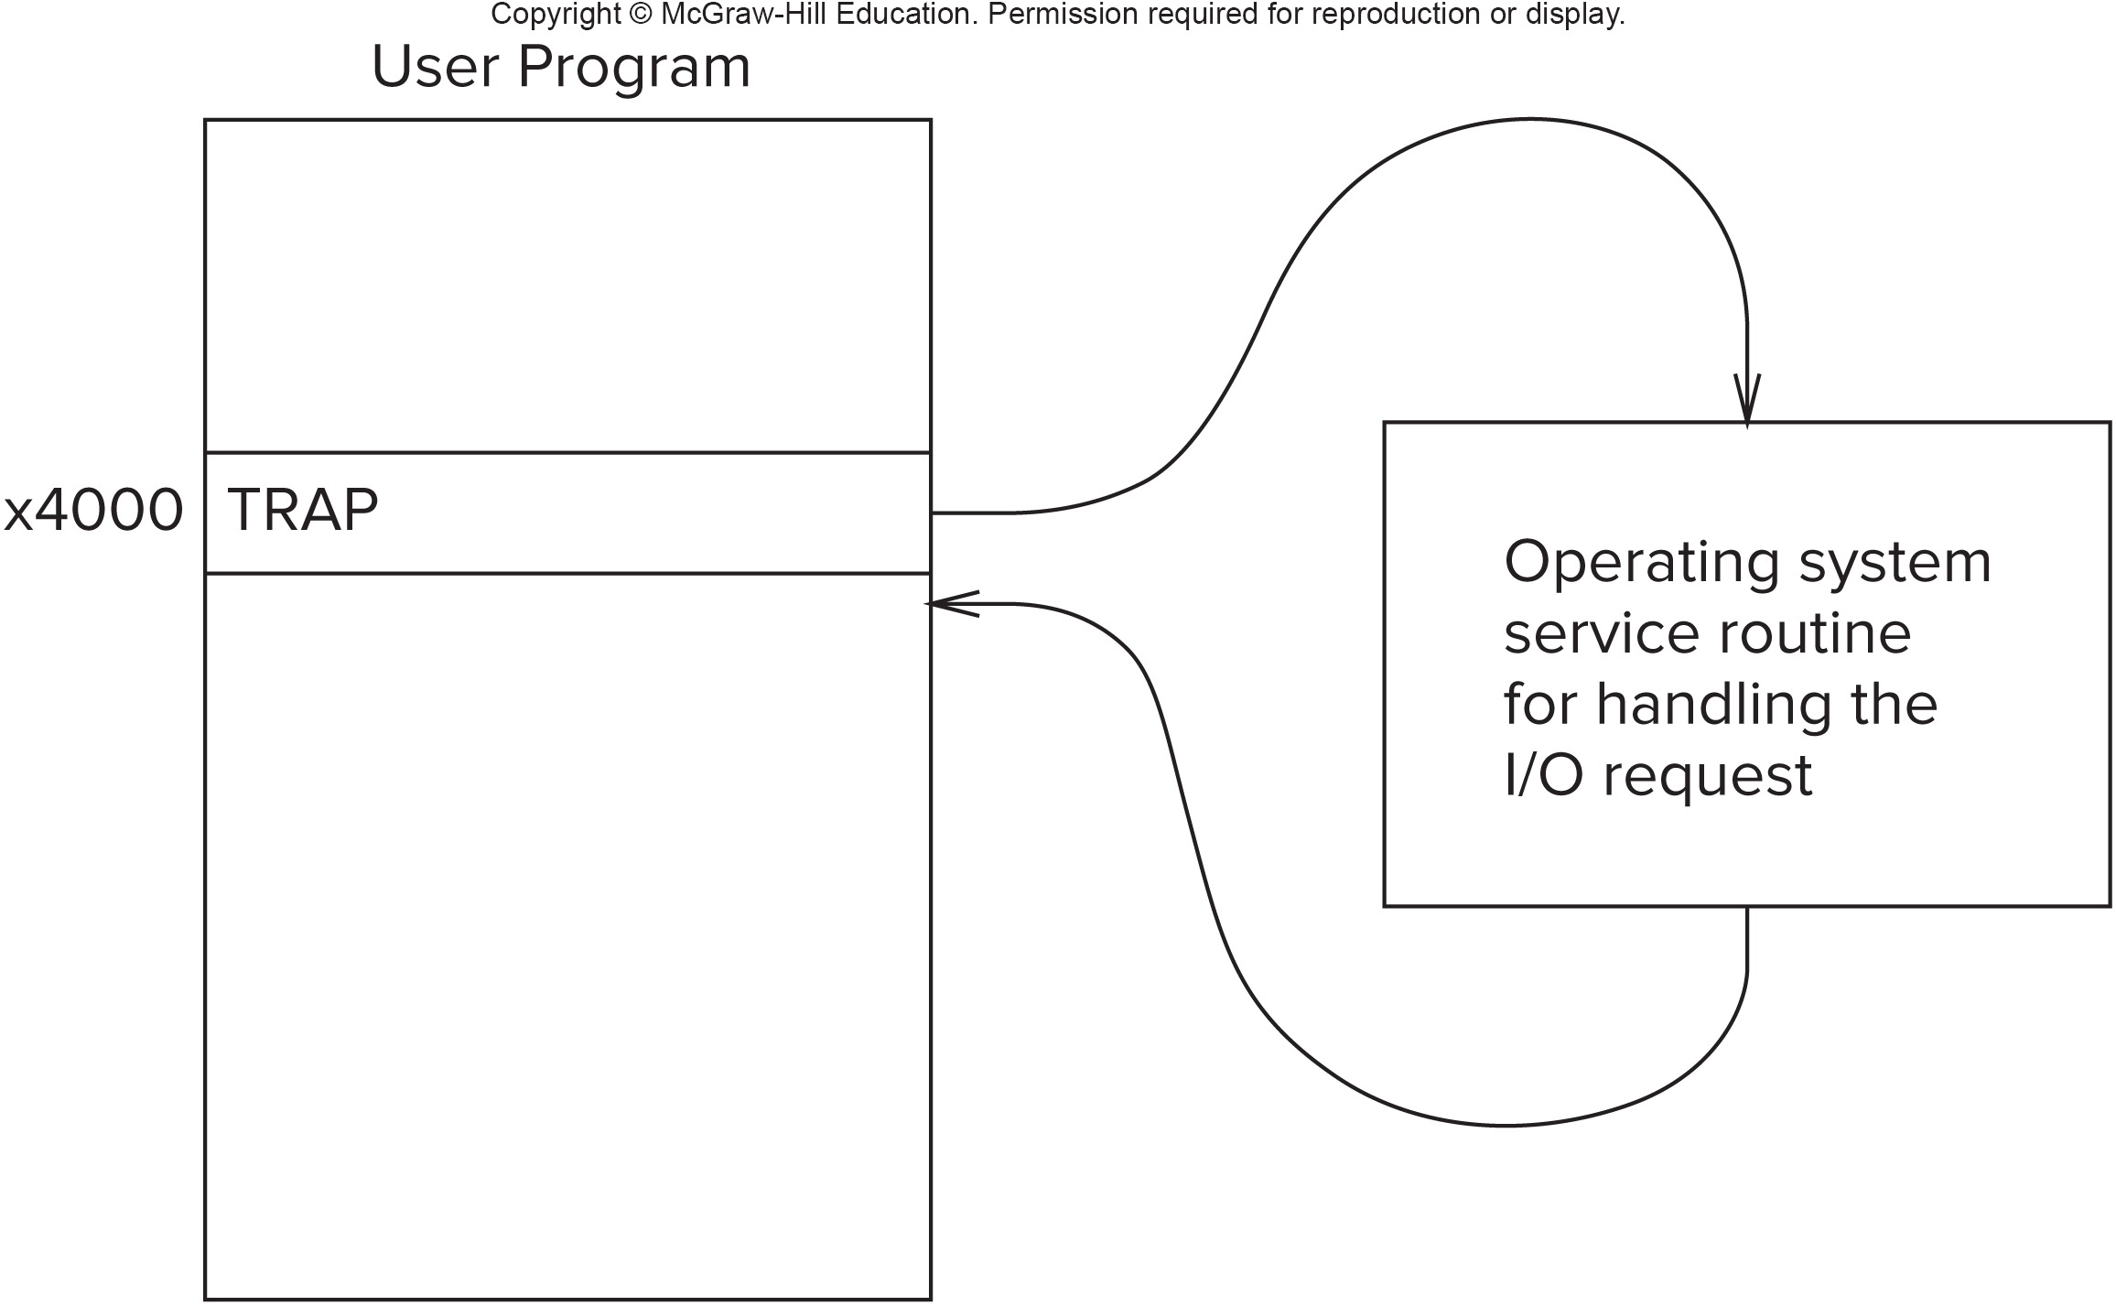
LC-3 Trap
That’s a lot of words! What do they mean!
Think of TRAP as a special indirect JSR with a choice of memory location from 0 through 255 (i.e. let’s call that trapvect).
The TRAP instruction saves state just like an Interrupt on the system stack

Slide 31
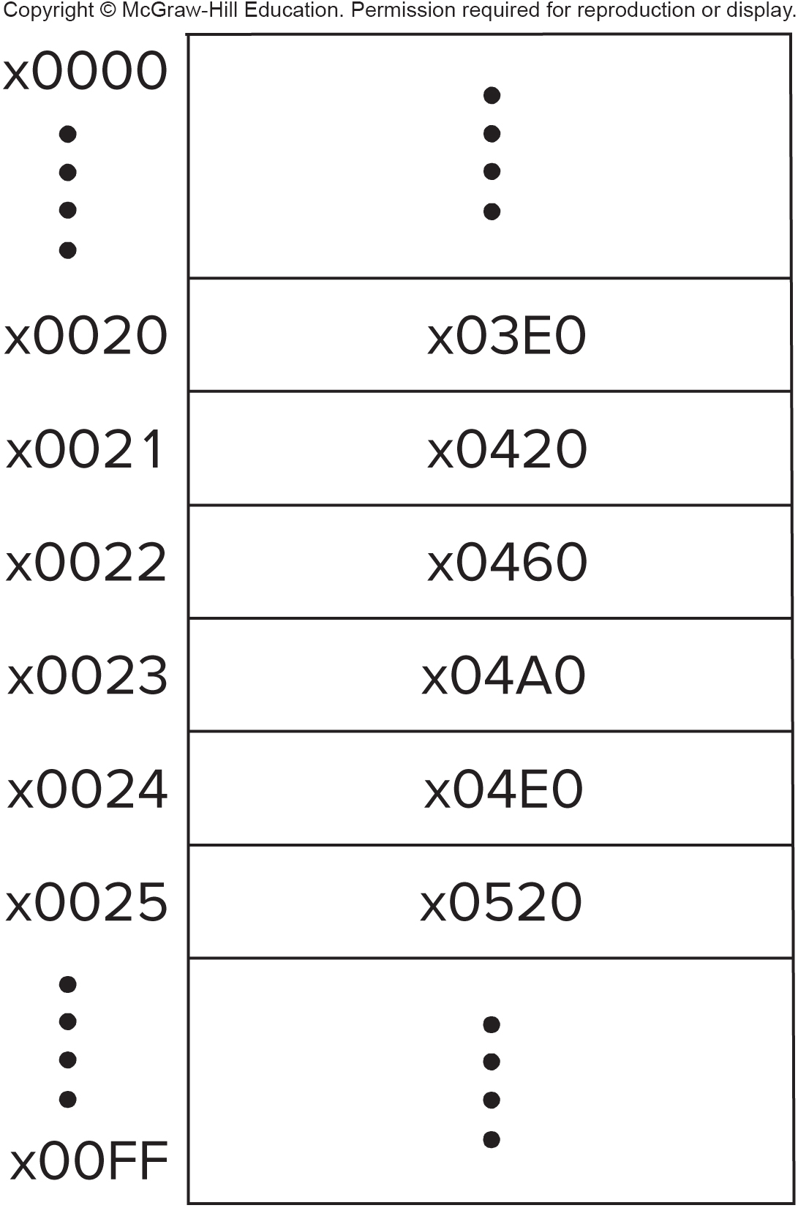
The Trap Vector Table
IN
subroutine
x0420
OUT
subroutine
x04A0
HALT
subroutine
x0520
Trap Vector Table

Slide 32
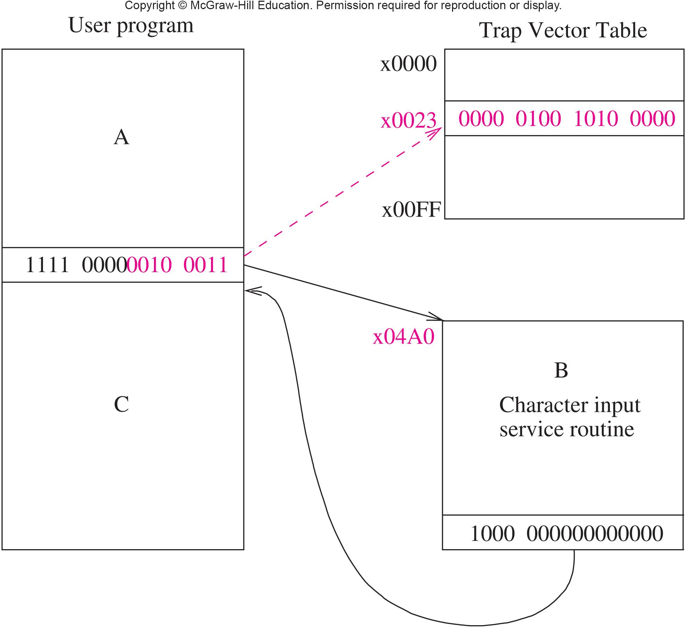
Calling the OUT Subroutine with TRAP

Slide 33
Executing a TRAP Instruction
TRAP
1111
0000
trapvect8
Zero extend trapvect8 to 16 bits and load into MAR
Read memory into MDR
R7 ← PC (The Linkage)
PC ← MDR

Slide 34
Common LC-3 Trap Numbers
TRAP
1111
0000
trapvect8
Vector | Routine
x23 | IN – prompt and read a character from the keyboard (R0)
x21 | OUT - output a character to the monitor (R0)
x25 | HALT - halt the program
x20 | GETC - read a character from the keyboard (R0)
x22 | PUTS - output a string, 1 char per word ending with x0000, address in R0
x24 | PUTSP - output a string, 2 characters per word ending with a word of x0000, address in R0
See Table A.2 p 543

Slide 35
Question???
What happens if there is no HALT instruction in our program?
Nothing, the processor will stop when it runs out of instructions
A memory boundary trap will occur
The processor will start to execute the data in memory words following our program
Zombies will come after you!
20

Slide 36
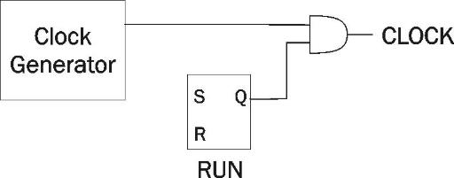
Stopping the Clock
The LC-3 FSM will repeat its instruction processing sequence as long as the clock is running.
If not processing instructions from your application, then it is processing instructions from the Operating System (OS) or running off into memory executing whatever is there.
No sense wasting a scarce opcode for HALT when we can use a trap routine in the OS that resets the RUN register to 0.
To stop the computer:
AND the clock generator signal with bit 15 of the MCR (machine control register), memory-mapped to 0xFFFE
When the FSM stops seeing the CLOCK signal change, it stops processing.
(bit 15 in MCR, 0xFFFE)

Slide 37
Trap Service Routines
The assembler will recognize aliases for certain predefined trap instructions
TRAP x20 GETC
TRAP x21 OUT
TRAP x22 PUTS
TRAP x23 IN
TRAP x24 PUTSP
TRAP x25 HALT

Slide 38
HOW DO WE GET BACK?

Slide 39
Compare & Contrast
JMP
1100
000
BaseR
000000
RET
1100
000
111
000000

Slide 40
Saving & Restoring Registers
Why should we save a register?
When should we save a register?
Who should save the register?
3

Slide 41
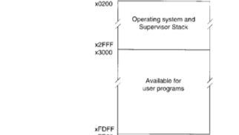
Memory Map of the LC-3

Slide 42
Exceptions
Now that we understand Interrupts and TRAPs, Exceptions are easy
Synchronous exceptions in the LC-3
Divide by zero (no divide in LC-3)
Illegal instruction (opcode=D, Table’Vector is 0x0101)
Privileged instruction (RTI in user mode, Table’Vector is 0x0100)
Address Violation (ACV, Table’Vector is 0x0102)
Asynchronous exceptions (not implemented on LC-3)
Processor error
Memory error
Handled like Interrupts, but of course the vectors point to exception service routines in the operating system

Slide 43
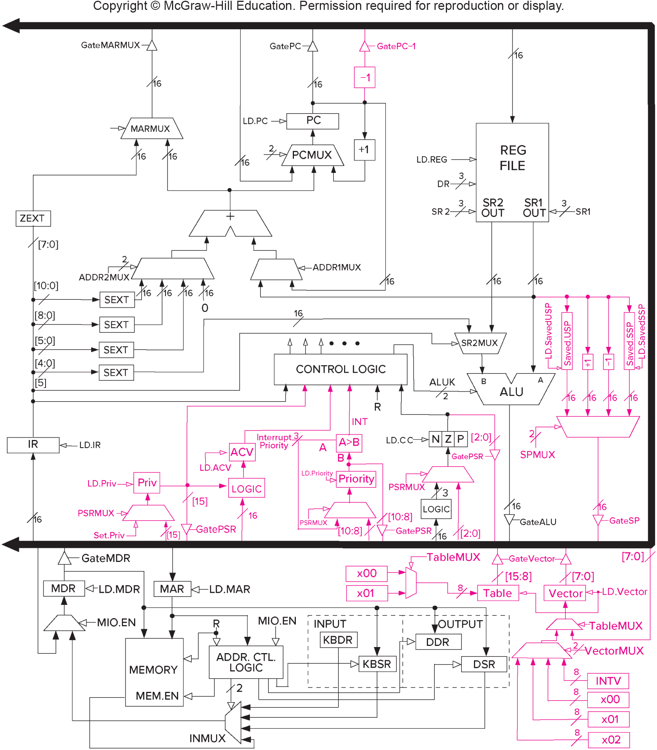
Program Discontinuity Logic, for Completeness (Fig C.8)

Slide 44
Questions?

